Slide 1

SRM INSTITUTE OF SCIENCE AND TECHNOLOGY
COLLEGE OF ENGINEERING AND TECHNOLOGY
DEPARTMENT OF NETWORKING AND COMMUNICATIONS
18CSP109L - MAJOR PROJECT
Design of Music Recommendation System Based on Facial Recognition using Mini-Xception CNN
Chandan Singh (RA1911031010076)
V. Himayanth (RA1911031010088)
BATCH ID:
NW291
Guide name:
Dr. B. BALAKIRUTHIGA

Slide 2
ABSTRACT
Due to the emerging developments in Artificial Intelligence and Machine Learning Technologies, various prediction systems are been developed based on human emotions and real time aspects of human psychology as well. Facial recognition system is one such mechanism which is the most vibrant strategy used for predicting human emotions. It is extensively applied in surveillance systems, fault identification and other security related aspects. Based on the human emotions researchers have already proposed several music recommendation systems. This paper aims to propose a Facial recognition-based music recommendation system to treat the psychology patients. This helps to recover the patients from mental stress, anxiety, and depression. The suggested method aims to take into account the limitations of the face recognition system in current frameworks, such as the requirement to lower the processing delay for deep feature extraction and the necessity to design a Mini exception technique based on Deep Convolutional Neural Network (DCNN) architecture. The FER- 2013 image dataset, which consists of 35000 face photos with automated labelling is considered. It is used to determine how well the proposed approach would detect the various emotion classes. In comparison to other states of methods, the Mini exception technique utilised in CNN layers acts as a lightweight system. The proposed solution has a 92% accuracy rate and removes the barrier between the current frameworks. The suggested music is taken from a music database and then further mapped in accordance with the algorithm's output.
2

Slide 3
INTRODUCTION
Human emotion is a unique one that cannot be easily predictable. The Real Emotion of the human being is expressed through facial expressions Christopher human feeling can be reflected by many kinds of actions.
In order to identify the human emotions and recommending the music related to the emotion is a demanding field of study in artificial intelligence.
Music recommendation system are often helpful to suggest the users recommended music patterns in automated way additionally using deep learning algorithms.
Music recommendation systems also relieve the stress of the humans during prolonged work and various environments. Identifying the human emotion is a highly important in a recent days where scientific innovations are created every day to identify the Real Emotion present with the human.
Some of the human emotions are categorised such as happy neutral angry contempt discussed scared etc.
3

Slide 4
INTRODUCTION
Facial expression is the first sign of human emotion where any changes in the real emotion of the human can be reflected in the facial expressions such as eyes nose mouth eyebrows etc.
Because of evaluation of recent Technology such as neural networks mission learning algorithm and deep learning algorithms detection of human emotion systems increasing. Various music recommendation data sets are available where 2013 consists of 35000 images with labelled emotions. The face data set consists of various emotions identified by the changes occurring in the facial skeleton.
Deep convolutional neural network algorithms are utilised in facial emotional recognition systems where the classification of facial emotion such as happy sad discussed are identified by the recommendation algorithm accurately.
The presented paper considers various constraints present with the facial recognition system such that the feature extraction and the similarity problem are overcome by accurately developing Mini exception model based facial recognition system.
4

Slide 5
MOTIVATION
Personalized music recommendations: By using facial recognition, the system can identify the user's emotional state and recommend music that is most likely to resonate with their current mood. This can provide a more personalized music listening experience.
Better user engagement: A music recommendation system that is able to accurately recommend songs based on a user's facial expression could increase user engagement with the platform. Users may be more likely to continue using the platform if they feel that it is providing them with music that matches their current mood.
Potential for commercial applications: Music recommendation systems have significant commercial potential, particularly if they are able to provide personalized recommendations that increase user engagement. A facial recognition-based system could be particularly useful for companies that are focused on marketing and advertising, as it could allow them to target users with music that is most likely to evoke a particular emotion or feeling.
Research purposes: Developing a music recommendation system based on facial recognition using Mini-Xception CNN could also have research implications, as it could help researchers better understand the relationship between facial expressions and emotional states. This could have applications in fields such as psychology and neuroscience.

Slide 6
LITERATURE SURVEY
S NO | Author | Title of Paper | Methodology | Year of publication and journal | Remarks
1 | Mohseni, S., Zarei, N., & Ramazani, S. | Facial Expression Recognition Using Anatomy Based Facial Graph | In this they have used Facial action coding system (FACS).It divides 46 different action units .They have also used Support Vector Machine(SVM) which performs an implicit mapping of data into a higher dimensional feature space , and then finds a linear separating hyper plane with maximal margin to separate features | Mohseni, S., Zarei, N., & Ramazani, S. (2019, October). Facial expression recognition using anatomy based facial graph. In 2019 IEEE International Conference on Systems, Man, and Cybernetics (SMC) (pp. 3715-3719). IEEE | The graph edges ratio instead of measuring displacement, which causes various errors due to head orientations but image scale variation is still a cause of error.
6

Slide 7
S NO | Author | Title of Paper | Methodology | Year and Journal | Remarks
2 | Mandal, Murari, Shashi Poddar, and Amitava Das. | Comparison of human and machine based facial expression classification | The proposed system consists of two parts: facial feature extraction and facial expression classification. The facial features were extracted using higher order Zernike moments and the features were classified by an ANN based classifier. | Mandal, Murari, Shashi Poddar, and Amitava Das. "Comparison of human and machine based facial expression classification." In International Conference on Computing, Communication & Automation, pp. 1198-1203. IEEE, 2019. | The image in training section was not repeated in the testing section. It is not so much required to know the exact emotion of a person but a general description of the state of mind of the person is sufficient.

Slide 8
S NO | Author | Title of Paper | Methodology | Year of publication and journal | Remarks
3 | Bavkar, S. S., Rangole, J. S., & Deshmukh, V. U. | Geometric Approach For Human Emotion Recognition Using Facial Expression | In this they developed a fully automatic method using anthropometric model. Anthropometry is a biological science that deals with the measurement of the human body and its different parts. The facial feature point’s localization has been found from proportional constants in using distance between eyes axis, mouth axis, symmetry axis and the face box center YC as the principle parameter of measurement. To localize feature points on face we have to find out MA, SA, EA and center of face box. | Bavkar, S. S., Rangole, J. S., & Deshmukh, V. U. (2017). Geometric approach for human emotion recognition using facial expression. International Journal of Computer Applications, 118(14). | Does Not extract properly if there are hairs on face area.

Slide 9
S NO | Author | Title of Paper | Methodology | Year and Journal | Remark
4 | Happy, S. L., & Routray, A. | Robust Facial Expression Classification Using Shape And Appearance Features | This paper represents an approach of combining the shape and appearance features to form a hybrid feature vector. They have extracted Pyramid of Histogram of Gradients (PHOG) as shape descriptors and Local Binary Patterns (LBP) as appearance features. By using linear discriminant analysis, the dimensionality of the feature is reduced which is further classified by using the support vector machine (SVM). | Happy, S. L., & Routray, A. (2015, January). Robust facial expression classification using shape and appearance features. In 2015 eighth international conference on advances in pattern recognition (ICAPR) (pp. 1-5). IEEE. | The eye regions were not selected as the features from these regions . Methods are not evaluated for out-of-plane head rotation due to unavailability of such databases

Slide 10
S NO | Author | Title of Project | Methodology | Year and Journal | Remark
5 | Chang, S. H., Abdul, A., Chen, J., & Liao, H. Y. | A personalized music recommendation system using convolutional neural networks approach | In this paper , a personalized music recommendation system (PMRS) based on the convolutional neural networks (CNN) approach. In PMRS, they propose a collaborative filtering (CF) recommendation algorithm to combine the output of the CNN with the log files to recommend music to the user. The log file contains the history of all users who use the PMRS. The PMRS extracts the user's history from the log file and recommends music under each genre. They use the million song dataset (MSD) to evaluate the PMRS. | Chang, S. H., Abdul, A., Chen, J., & Liao, H. Y. (2018, April). A personalized music recommendation system using convolutional neural networks approach. In 2018 IEEE International Conference on Applied System Invention (ICASI) (pp. 47-49). IEEE. | Facial recognition system is not available

Slide 11
S NO | Author | Title of Paper | Methodology | Year and Journal | Remark
6 | Siritanawany, P., & Kotani, K. | Facial Expression Classification By Temporal Template Features | In this paper, we deal with the problem by modeling the temporal template from the facial image sequences by using Motion History Image (MHI) or Cumulative Change of Feature (CCF), then we apply these features into the conventional linear classifier (EMC) or non-linear classifiers (KEMC and KNN). | Siritanawany, P., & Kotani, K. (2018, September). Facial expression classification by temporal template features. In 2018, Proceedings of the SICE Annual Conference (SICE) (pp. 604-609). IEEE. | Temporal template is that the performance can be corrupted by the head motion and shape deformation of face around the edge of face.

Slide 12
Challenges and limitations in existing system
Accuracy: One of the biggest challenges associated with facial recognition-based music recommendation systems is accuracy. While the Mini-Xception CNN architecture is designed to improve accuracy, there are still limitations to the technology.
Limited dataset: Another limitation of the existing system is the size of the dataset. The accuracy of the system is largely dependent on the number and diversity of the images used to train the neural network.
User privacy: Facial recognition-based music recommendation systems raise concerns about user privacy. Some users may be uncomfortable with the idea of a system analyzing their facial expressions to make music recommendations, particularly if they are not aware that their image is being used in this way.
Hardware requirements: The Mini-Xception CNN architecture is a deep learning algorithm that requires significant computational power to run. This may limit the scalability of the system, particularly if it needs to be deployed on a large scale or across multiple devices.
Unpredictable user behavior: Facial expressions can be influenced by a wide variety of factors, including external stimuli, personal experiences, and cultural differences. .

Slide 13
Objectives of the project
The primary objective of this system is to provide a more personalized and engaging music listening experience for users, with the potential to increase user engagement with the platform. By using facial recognition to identify the user's emotional state, the system aims to provide music recommendations that are more relevant and meaningful to the user, and that can help to enhance their overall music listening experience.
In addition to providing personalized music recommendations, a secondary objective of this system may be to advance research in the field of affective computing, which is focused on developing computational models of human emotions and affective states.
By analyzing facial expressions and identifying patterns that correspond to different emotional states, this system may contribute to our understanding of how emotions are expressed and recognized in human communication.

Slide 14
Innovation idea of the project
The innovation idea for a Music Recommendation System Based on Facial Recognition using Mini-Xception CNN is to integrate other forms of user data and feedback to improve the accuracy of the music recommendations. Specifically, the system could incorporate information on the user's recent listening history, preferred genres, and favorite artists to better contextualize their current emotional state and provide more personalized recommendations.
For example, if the user is currently expressing a sad or melancholic facial expression, the system could recommend songs that are not only emotionally appropriate but also fall within the user's preferred genres and artists. This could be accomplished through the use of collaborative filtering techniques and machine learning algorithms that analyze the user's listening history, social media activity, and other behavioral data.
Additionally, the system could allow for user feedback on the accuracy of the music recommendations, such as by allowing users to rate the relevance of the recommended songs or provide feedback on the accuracy of the facial recognition algorithm. This feedback could be used to further train and refine the Mini-Xception CNN algorithm, improving the overall accuracy of the system over time.

Slide 15
Scope and application of the project
Music streaming platforms: Music recommendation systems based on facial recognition using Mini-Xception CNN could be integrated into popular music streaming platforms such as Spotify, Apple Music, and Tidal to provide more personalized and engaging music recommendations for users.
Retail and marketing: The technology could also be used in retail and marketing settings to provide music recommendations that are tailored to the current emotional state of the consumer. This could be particularly useful for marketing campaigns that aim to evoke a particular emotion or feeling in consumers.
Mental health and wellness: Music recommendation systems based on facial recognition could be used in mental health and wellness settings to help individuals manage their emotional state. For example, the technology could be integrated into apps or online platforms that offer meditation or therapy services.
Entertainment and gaming: Music recommendation systems could also be used in entertainment and gaming settings to provide more personalized and immersive experiences for users. For example, a game could use the technology to dynamically adjust the game's soundtrack based on the emotional state of the player.
Research and development: The technology could be used in research and development settings to better understand the relationship between facial expressions and emotional states. This could have applications in fields such as psychology, neuroscience, and affective computing.

Slide 16
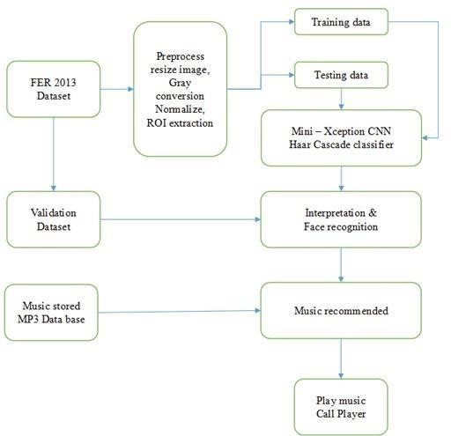
ARCHITECTURE DIAGRAM

Slide 17
In this architecture, the system begins by receiving user input in the form of a facial image or video. The facial recognition module then processes this input and extracts relevant features such as facial landmarks, expressions, and emotions. This data is then passed to the emotional state recognition module, which uses Mini-Xception CNN to analyze the facial features and determine the user's current emotional state.
Based on the emotional state recognition output, the music recommendation engine generates a set of recommended songs or playlists that match the user's current mood. This engine could use various recommendation algorithms such as collaborative filtering, content-based filtering, or hybrid approaches to provide personalized music recommendations.
Finally, the system outputs the recommended music to the user, which they can then listen to through their preferred music streaming service or application. The system could also collect feedback from the user on the accuracy of the recommendations, which could be used to improve the system over time.

Slide 18
PROPOSED ALGORITHM
In this proposed system Input video is taken from camera and then the input video is moved to Haarcascade process, this technique is used to detect the human face and there is no need of training data’s. Preprocessing and feature extraction all are done within the haarcascade. Then the video frame is moved to neural network.
Here we use convolution neural network to classify the emotion of human based on their face expression whether it can be angry, happy,sad,normal then the recommendation system will recommend a music based on their emotion.
Algorithms Used:
1)Haar Cascading
2)Convolutional Neural Network
3)Mini-Xception

Slide 19
Haar Cascading
Haar Cascading is the machine learning method where a classifier is drilled from a great deal of positive and negative photos.
A positive image is one containing an object that must be detected, a negative image is one not containing a need-to-find object
Haar feature-based cascade classifiers are the classifiers implemented for object detection.
Face detection and facial expressions in an image are also successfully detected.
The exercise is finished by offering positive and negative pictures to the classifier. Then the characteristics are drawn out from the picture.
Preprocessing and feature extraction all are done within the haarcascade.

Slide 20
Preprocessing
Preprocessing is preparing the data for further analysis. It has the following techniques 1. resizing 2.colour conversion and 3.filtering
Preprocessing technique is used to remove unwanted data and filter our input video
It will compress our input video and this method will make further execution quickly.

Slide 21
Convolution Neural Network
CNN is a machine learning algorithm that can take in an input image, assign importance (learnable weights and biases) to various aspects/objects in the image, and be able to differentiate one from the other.
Convolutional Neural Networks specialized for applications in image & video recognition. CNN is mainly used in image analysis tasks like Image recognition, Object detection & Segmentation.
There are three types of layers in Convolutional Neural Network:
1. Input Layer
2.Hidden Layer
3. Output Layer

Slide 22
Convolution Neural Network
Input Layer– First is the input layer. This layer will accept our input video pixels and pass it to the rest of the network.
Hidden Layer– The second type of layer is called the hidden layer. Hidden layers have number of convolution layers and max pooling layers. In our project we use 2D convolution networks. Hidden layers are the ones that are actually responsible for the excellent performance and complexity of neural networks.
Output layer– The last type of layer is the output layer. The output layer holds the result or the output of the problem. Here it give emotion classification(happy/sad/angry/normal)

Slide 23
Mini-Xception
For this the best architecture to detect emotion is mini-Xception.
Mini-Xception algorithm is applied on emotion detection dataset. Dataset contains 35,887 images. Accuracy is calculated from the confusion matrix. Dataset: To train our models we used dataset: FER-2013.
Xception is a convolutional neural network that is 71 layers deep, we can load a pretrained version of the network trained on more than a million images from the ImageNet dataset.
Xception is also known as “extreme” version of an Inception module.

Slide 24
MODULE DESCRIPTION
The first process in our system is the detection of the face expression for emotion classification. There are a lot of algorithms for this such as Histogram of Oriented Gradients (HoG) method which is a widely used process for face detection as well as object detection.
This algorithm is a very powerful feature descriptor which uses linear SVM Machine learning algorithm along with it. The second-best algorithm is HaarCascade classifier. This process which was first invented described the method to detect object in real time using Haarcascade classifier.
We implemented the similar process in our work so as to detect the faces in real time along with the faces at different angles. There are more algorithms for face detection but this process can be easily applied.
This process captures the image by frames and then they are sent to the Haarcascade classifier algorithm, converted to grayscale, cloned for drawing and then the ROI of face is captured and sent to the CNN model for image classification.

Slide 25
Face can also be detected from a video or an image which is processed with the same method.
The next process is the image classification which means after the face is detected, it has to be passed through CNN layers for describing the type of emotion.
We trained the model using datasets containing images of Neutral, Happy, Sad, Surprised, Scared, Angry, Disgust emotions. In order to classify images into certain emotions, CNN can automatically learn that means it learns the features by itself.
The CNN contains various layers which train and test the datasets of images and then use it for generating emotions.
The dataset is classified into 2 groups before entering the CNN- 80% of the datasets are used for training and 20% are used for testing

Slide 26
Then testing is performed in the model after the images are trained using CNN.
During testing, the accuracy is calculated by checking if the facial image is classified accurately or not.
Accuracy of the image classification can be increased either by increasing the number of epochs in the testing time or the number of images in the dataset; to increase the number of images of the dataset, augmentation techniques are used
In the architecture which is used for training the system, images are taken from FER2013 dataset which is then preprocessed and split into two-80% for training and 20% for testing, training sets are divided into two parts x-train (feature extraction) and ytrain(labelling) for the convenience of passing through the multiple layers of CNN.
This split data set is then passed into the CNN algorithm of mini-xception

Slide 27
The test input or real time input is then passed for preprocessing and then it is transferred to the trained model for classification of the facial expression and then sent to the music mapping algorithm made to provide the songs to the user in Youtube.

Slide 28
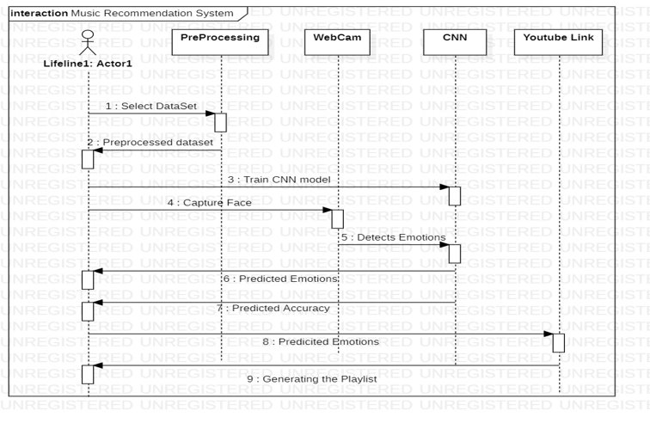
UML DIAGRAM

Slide 29
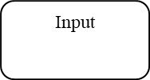
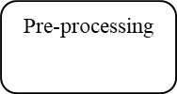

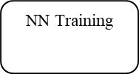
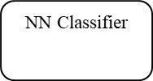
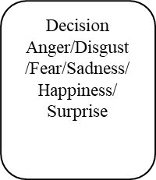

BLOCK DIAGRAM

Slide 30

INPUT/OUTPUT

Slide 31
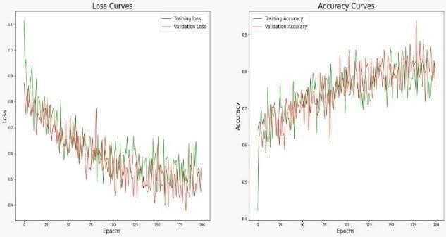
LOSS & ACCURACY GRAPHS

Slide 32
The term "validation accuracy" refers to the accuracy presented during testing, "training accuracy" refers to the accuracy achieved during model training (using the FER dataset) as indicated by training accuracy point.
It has already exceeded the 95% validation accuracy threshold. This means that the model can achieve higher accuracy with more data. You can see this in the graph you're looking at now. This shows that after only 200 epochs we get an average accuracy of 80%.
We paused the model after it completed 200 epochs and plotted the following chart. This is because the calculation of loss and precision takes a lot of time.

Slide 33
REFERENCES
[1]. Gilda, Shlok, “Smart music player integrating facial emotion recognition and music mood recommendation.” 2017 International Conference on Wireless Communications, Signal Processing and Networking (WiSPNET). IEEE, 2017.
[2]. Florence, S. Metilda, and M. Uma. “Emotional Detection and Music Recommendation System based on User Facial Expression.” IOP Conference Series: Materials Science and Engineering. Vol. 912. No. 6. IOP Publishing, 2020.
[3]. Vinay p, Raj p, Bhargav S.K., et al. “Facial Expression Based Music Recommendation System", International Journal of Advanced Research in Computer and Communication Engineering, IJARCCE.2021.10682, 2021
[4]. Samuvel, D. J., Perumal, B., & Elangovan, M. (2020). Music recommendation system based on facial emotion recognition. 3C Tecnología. Glosas de innovación aplicadas a la pyme. Special edition 261-271, March 2020.

Slide 34
[5]. S. Bhat, V. S. Amith, N. S. Prasad and D. M. Mohan, “An Efficient Classification-Algorithm for Music Mood Detection in Western and Hindi Music Using Audio Feature Extraction,” 2014 Fifth International Conference on Signal and Image Processing, pp. 359-364, 2014.
[6]. Londhe RR and Pawar DV 2012 Analysis of facial expression and recognition based on statistical approach, International Journal of Soft Computing and Engineering (IJSCE) ISSN: 2231-2307, Volume-2Issue-2, May 2012.
[7]. Z. Zeng, M. Pantic, G. I. Roisman and T. S. Huang, “A Survey of Affect Recognition Methods: Audio, Visual, and Spontaneous Expressions,” in IEEE Transactions on Pattern Analysis and Machine Intelligence, vol. 31, no. 1, pp. 39-58, Jan. 2009.
[8]. Xianghua Fan, Fuyou Zhang, Haixia Wang and Xiao Lu, “The system of face detection based on OpenCV,” 24th Chinese Control and Decision Conference (CCDC), pp. 648- 651, 2012.

Slide 35
PLAGIARISM
Research Paper - 9%
Project Report - 8%

Slide 36

STATUS OF PAPER

Slide 37


Slide 38
Thank You

